Slide 1

Semantic Web Principles and Practice
Class 2: 13 May 2009

Slide 2

Class 2: Roadmap
Announcements and Assignments
Schraefel paper
Madin paper
XML - SWP slides

Slide 3
Announcements: Readings
Reading schedule change - see web site
Readings:
SWWO - Ch 2
SWP - Ch 2
LinkedData.org - read Berners-Lee, Bizer et al, Hausenblass (both) and explore site
FOAF - try it!
WordNet - explore it
Read Info Overload (3 parts)

Slide 4
Announcements: Assignments
Writing: 2 page response to Info Overload
Experience: use FOAF (next slide) and 1 page report.
Programming: XML project

Slide 5
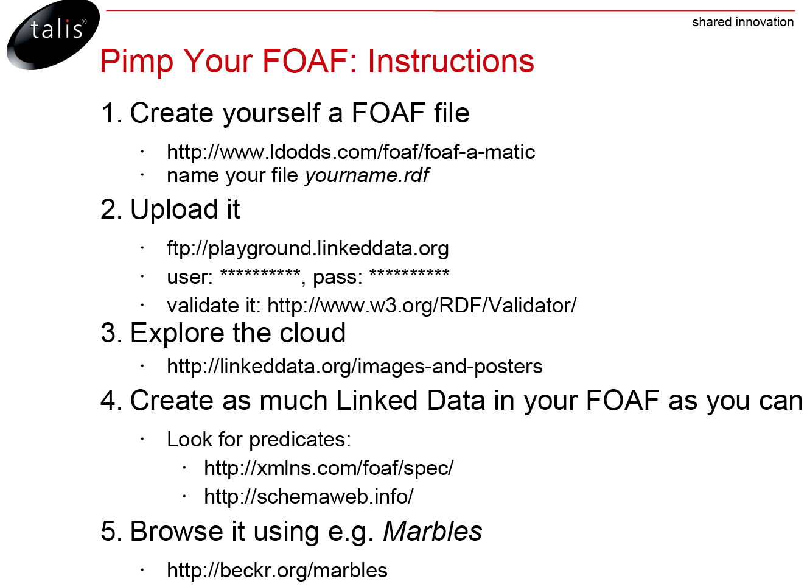
FOAF

